Slide 1

ChatSonic
Group 9:
Abdulrahman Almyman–
Waleed Alnajashi–

Slide 2
Introduction
What is ChatSonic ?
ChatSonic is an incredibly powerful conversational AI chatbot, it can generate engaging content within minutes. Founded by Samanyou Garg in 2020, it has its headquarters in San Francisco, USA .

Slide 3
Company and founders
Writesonic is an AI-powered writing assistant platform founded by Samanyou Garg in 2020 [2]. Samanyou is an entrepreneur with a passion for solving complex real-world problems using AI [1]. He is also the CEO of Writesonic [2]. In October 2020, Sam created an AI-powered landing page generator to help create great copy for his digital products. In January 2021, Writesonic launched its AI Article/Blog Writer, which generated a full-length article with the input of a few words. This feature became the most popular and was named "Best AI writer of 2021" by TechRadar [3]. The award has since been extended to "Best AI writer of 2022." The company plans to continue building a comprehensive platform to help people write with confidence and achieve their goals [3].
References:
[1] Samanyou Garg - Founder and CEO - Writesonic (YC S21)
[2] Samanyou Garg - Founder and CEO @ Writesonic
[3] About Writesonic | We Help You Scale Content Production

Slide 4
ChatSonic vs ChatGpt :
ChatGPT is restricted by the inputs or training data (up till 2021) that cannot be updated as regularly. On the other hand, Chatsonic is a more advanced and powerful version that can keep up with current news and events, granting it an advantage in terms of precision and dependability.[1]
References:
[1] https://writesonic.com/compare/chatsonic-vs-chatgpt

Slide 5
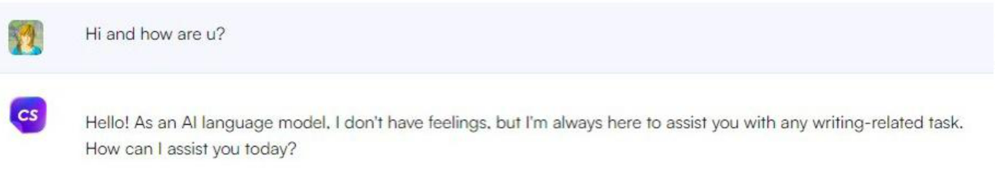
Testing the product

Slide 6
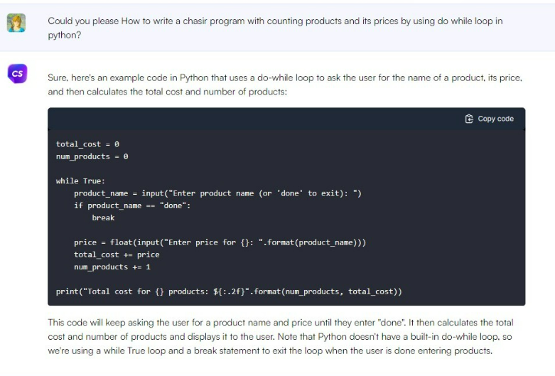
Testing the product:

Slide 7
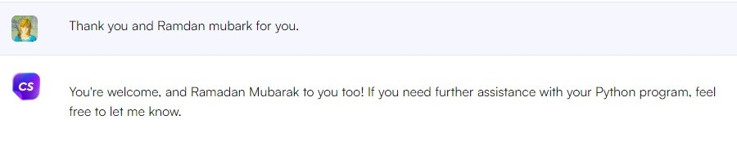
Testing the product:

Slide 8

Revenue (2021):
In 2021 Chatsonic generated $1M in revenue.

Slide 9
Revenue (2022-2025):
Chatsonic is expected to generate $1M – $2M in 2025

Slide 10
Thank you for listening
Abdulrahman Almyman
Waleed Alnajashi

